Slide 1
Lecture 06
Semantic Analysis

Slide 2
Where We Are
Source
Code
Lexical Analysis
Syntax Analysis
Semantic Analysis
IR Generation
IR Optimization
Code Generation
Optimization
Machine
Code

Slide 3
while (y < z) {
int x = a + b;
y += x;
}
Lexical & syntax analysis
While
void
While
Semantic analysis
<
bool
Sequence
void
<
Sequence
y
z
=
int
=
int
y
z
=
=
int
int
int
x
+
y
+
x
+
y
+
int
int
int
a
b
y
x
a
b
y
x
int
int
int
int

Slide 4
Where We Are
Program is lexically well-formed:
Program is syntactically well-formed:
Have the correct structure/ syntactically valid.
Does this mean that the program is legal?

Slide 5
A Short Program
class MyClass implements MyInterface {
string myInteger;
void doSomething() {
int[] x = new string;
x[5] = myInteger * y;
}
void doSomething() {
}
int fibonacci(int n) {
return doSomething() + fibonacci(n – 1);
}
}

Slide 6
A Short Program
class MyClass implements MyInterface {
string myInteger;
void doSomething() {
Interface not
declared
Can't multiply
strings
int[] x = new string;
x[5] = myInteger * y;
Wrong type
}
void doSomething() {
Can't redefine
}
int fibonacci(int n) {
Variable not
declared
functions
return doSomething() + fibonacci(n – 1);
}
}
Can't add void
No main function

Slide 7
Semantic Analysis
Ensure that the program has a well-defined meaning.
Verify properties of the program that aren't caught during the earlier phases:
Variables are declared before they're used.
Expressions have the right types.
Classes don't inherit from nonexistent base classes
…
Once we finish semantic analysis, we know that the user's input program is legal.

Slide 8
Typical examples of Semantic Analysis
Type Checking:
Whether the types of operands of a operator are equal？
Whether the types of the left and right hand side of assignment are equal？
Whether the type of index of array is proper?
Others:
Whether an identifier used has been declared?
Has V been declared to be a variable of array type for “V[E]” ?

Slide 9
Limitations of CFGs
Using CFGs:
How would you prevent duplicate class definitions?
How would you differentiate variables of one type from variables of another type?
For most programming languages, these are provably impossible.
Attribute Grammars are used to describe the semantic rules for semantic analysis.

Slide 10
Outline
Semantic Analysis
Attributes and Attribute Grammars
Dependency Graphs and Algorithms for Attribute Computation
Symbol Table and Scope Checking
Type Checking for Semantic Analysis of a Program

Slide 11
I. Attributes and Attribute Grammars
Attribute grammars are used to describe the semantic rules
Definition of Attribute: An attribute is any property of a programming language construct
Typical examples of attributes are:
The data type of a variable
The value of an expression
The object code of a procedure

Slide 12
Attribute
Attributes are associated directly with the grammar symbols (terminals and nonterminals)
If X is a grammar symbol, and a is an attribute associated to X, then the value of a associated to X is written as X.a

Slide 13
Attribute Equation (or Semantic Rule)
Given a collection of attributes a₁ , . . . , a_{k},
for each grammar rule X₀→X₁ X₂ . . . X _{n}, the values of the attributes X_{i} .a_{j} of each grammar symbol X_{i} are related to the values of the attributes of the other symbols in the rule
Attribute equation has the form
X_{i} .a_{j} = f_{ij} (X₀.a₁ , …, X₀.a_{k} ,X₁.a₁ , …, X₁.a_{k} , …, X_{n} .a₁ , …, X_{n} .a_{k} )
where f_{ij} is a mathematical function of its arguments
grammar rule
Attribute equation
number1->number2 digit | number1.val=number2.val*10+digit.val

Slide 14
Attribute Grammar
An attribute grammar for the attributes a1,…,ak is the collection of all attribute equations, for all the grammar rules of the language
Typically, attribute grammars are written in tabular form
Grammar Rule | Semantic Rules
Rule 1 | Associated attribute equations
…
Rule n | Associated attribute equations

Slide 15
Example 1
Attribute grammar for unsigned numbers
Attribute of a number is its value
Grammar rule | Semantic Rule
number1->number2 digit | number1.val=number2.val*10+digit.val
number->digit | number.val=digit.val
digit->0 | digit.val=0
… | …
digit->9 | digit.val=9

Slide 16
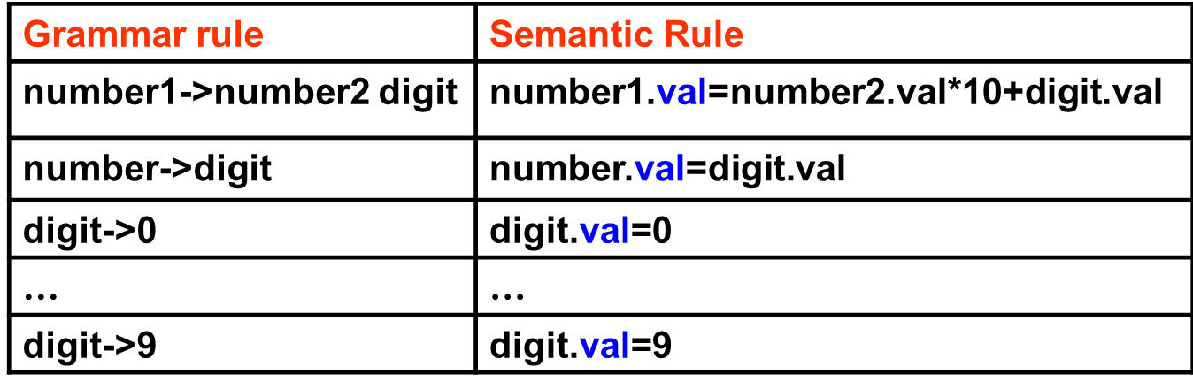
The meaning of the attribute equations for a particular string can be visualized using the parse tree for the string
number
(val=34*10+5=345)
number
digit
(val=3*10+4=34)
(val=5)
number
digit
5
(val=3)
(val=4)
digit
4
(val=3)
Parse tree for “345” showing attribute computations
3

Slide 17
Example 2
Attribute grammar for variable declarations
Attribute of the variable is data type
Grammar rule | Semantic Rules
decl->type varlist | varlist.dtype=type.dtype
type->int | type.dtype=integer
type->float | type.dtype=real
varlist1->id,varlist2 | id.dtype=varlist1.dtype varlist2.dtype=varlist1.dtype
var-list->id | id.dtype=varlist.dtype

Slide 18
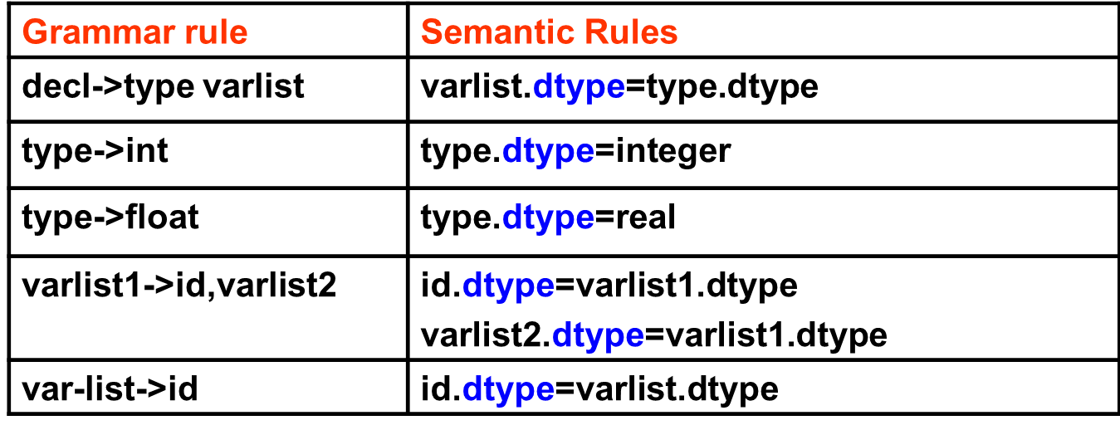
Parse tree for the string “float x,y” showing the dtype attribute
decl
type
varlist
(dtype=real)
(dtype=real)
id(x)
varlist
float
,
(dtype=real)
(dtype=real)
id(y)
(dtype=real)

